Slide 1
COMP 1516
Programming Fundamentals with Python – Lesson 11
Object-oriented Python

Slide 2
Learning Outcomes
Define Object-Oriented Programming (OOP)
Contrast with Procedural Programming (which we have done so far)
Identify the parts of a class definition
Identify the relationship between a class and an object

Slide 3
Classes
Object-oriented programming involves writing classes
A class is a Python file which describes the data and behaviors of a general category
The data are variables (adjectives and nouns) called “instance variables”, “fields”, or “properties”
The behaviors are functions (verbs) called “methods”
Examples:
Class | Data | Behaviors
Book | title, author_name, year_published, num_pages, price_usd | read(), censor(), update_price()
Dog | name, breed, weight_kg, date_born | neuter(), walk(), fetch()
MobilePhone | brand, model, version, color, price_usd | text(), purchase()
BankAccount | balance_usd, date_opened | transfer(), deposit(), withdraw()
Car | ? | ?
Notes:
Abstraction – hide details
Encapsulation – self contained
Inheritance – objects can inherit attributes and behaviors from other objects (parent/child)
Polymorphism – child objects an override behavior of parent objects – different meaning in different contexts

Slide 4
Objects
Object-oriented programming involves creating objects
Once a class has been defined, individual objects can be made of it
An object is one particular instance of a class
Ints and floats and strings are objects of their respective classes!
Examples:
Class | Objects
Book | Harry Potter, Python for Everybody
Dog | My dog, your dog, Toto from “The Wizard of Oz” movie
MobilePhone | My iPhone 13, your iPhone 13, your Samsung Galaxy S22 Ultra
BankAccount | My wife’s bank account, Bill Gates’ bank account
String | “Hello world”, “5”, “whatever”, ‘the end’
Int | 5, 0, -699987
Car | ?
Notes:
Abstraction – hide details
Encapsulation – self contained
Inheritance – objects can inherit attributes and behaviors from other objects (parent/child)
Polymorphism – child objects an override behavior of parent objects – different meaning in different contexts

Slide 5
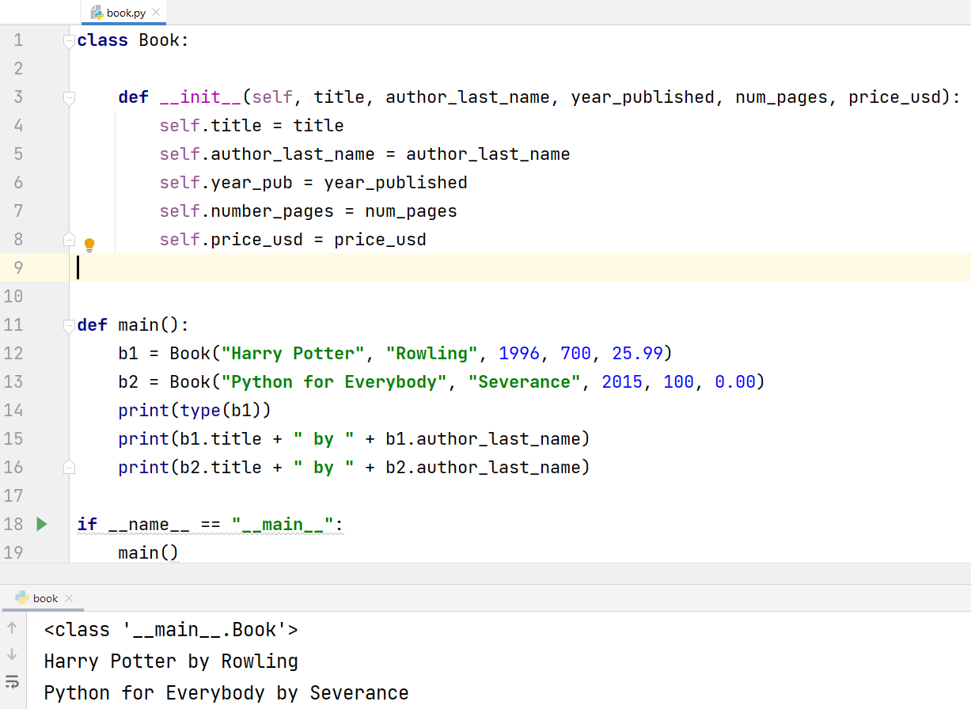
Classes and Objects

Slide 6
OOP: Benefits
Code and test re-use – within and across software applications
E.g. a Person class can be reused often (Employees, Students, Librarians, Dentists….)
Design: Can force better up-front planning and design for larger projects
Testability: At the object level (unit tests)
Extensibility: Adding new data/behavior to objects
Simplicity: The real world is full of objects; it’s easier to talk about my kids as people objects rather than as groups of atoms or molecules; likewise it’s easier to solve problems in computing with objects such as “Books” and “Library Customers” rather than using just strings and ints and floats etc.

Slide 7
Analogy
A class is like a new data type.
An object is like a variable of that type.
x = 5 # x is an integer object with value 5
x = -42 # x is an integer object with value -42
dog1 = Dog(“Rocky”) # dog1 is a Dog object with name value “Rocky”
dog2 = Dog(“Rex”) # dog2 is a Dog object with name value “Rex”
# someone has defined a class named “Dog” already # for this code to be working

Slide 8
Constructor
Constructor: def __init__(self):
The constructor is a method that is called automatically as an object is being created
It is used to set up the new object and its attributes with valid data
E.g. student = Student(“A005”); // no. this is not a valid student number! Raise an error!?
student=Student(“A00123456”); // fine
The constructor’s job is to fix bad data values when creating an object, and to store good data values into the newly-created object…or else raise an Exception.
The constructor is called automatically upon object creation: d = Dog() # __init__ is called

Slide 9
Dog
dog.py
main.py
class Dog:
"""The attributes and behaviors for all dogs go here."""
# constructor: code that is called automatically each time
# a Dog object is made
def __init__(self, name, weight_kg, year_born, breed):
self.name = name
self.weight_lb = weight_kg * 2.2
self.birth_year = year_born
self.breed = breed
The variables prefixed with “self.” are the object’s attributes
from Dog import Dog
def main():
dog1 = Dog("Rocky", 45.4, 2013, "Pitbull")
dog2 = Dog("Snoopy", 79.1, 2018, "German Shepherd")
print(dog1.name)
print(dog1.weight_lb)
print(dog1.birth_year)
print(dog1.breed)
print("---------------------")
print(dog2.name)
print(dog2.weight_lb)
print(dog2.birth_year)
print(dog2.breed)
if __name__ == "__main__":
main()
Rocky
99.88000000000001
2013
Pitbull
---------------------
Snoopy
174.02
2018
German Shepherd

Slide 10
Python example: Book class
class Book:
def __init__(self, title, num_pages):
# constructor
# the next 2 lines store the parameters into
# this object's instance variables (attributes)
self.title = title
self.number_of_pages = num_pages
def print_book_details(self):
print("%s has %d pages" % (self.title, self.number_of_pages))
# first Book object
book1 = Book("Harry Potter", 700)
# second Book object
book2 = Book("Lord of the Rings", 600)
print(book1.title) # accessing book1's attributes
print(book1.number_of_pages)
book1.print_book_details() # call book1's methods
print(book2.title)
print(book2.number_of_pages)
book2.print_book_details() # call book2's methods
book1 and book2 are objects of the Book class
print_book_details() is a Book method
self.title and self.number_of_pages are Book attributes (aka fields/instance variables)
title and num_pages are method parameters which are destroyed when the constructor finishes running
the important part of the constructor is the actual assignment of parameter values to instance variables (shown in bold here)
could create a class BookStore with a list of Book objects

Slide 11
Class vs. Object
Class – There is one class definition for an entire general category. It is the code that defines the structure – i.e., attributes and methods – that all objects of this class will have. E.g. class Dog stores all the data (e.g. breed) and behaviors (e.g. bark()) common to all dogs.
Object – Many objects can be created from a class. Each object will have the same attributes and methods as per the class definition. The VALUES of the attributes – i.e., the state – can be different for each object. E.g. My dog is a pitbull and barks loudly; another dog could be a pug and barks quietly.

Slide 12
BankAccount Demo
Bill Gates’ account # 12345
Let’s create a BankAccount class and BankAccount objects
A BankAccount represents a bank account in a bank
What attributes would the BankAccount class have?
What methods would it have?
BankAccount
Class
Your account # 98765
Your brother’s bank account # 44444

Slide 13
Python Best Practices: Basics
DocString your methods
Class Name: CapWords nouns
E.g. class BankAccount
Attributes: lower_snake_case adjectives or nouns
E.g. account_balance_usd
Methods: lower_snake_case verbs
E.g. get_account_balance_usd()
Notes:
Demo on PyCharm

Slide 14
student.py
class Student:
def __init__(self, student_id, first_name, last_name, year_born, courses):
self.student_number = student_id
self.first_name = first_name
self.last_name = last_name
self.year_of_birth = year_born
self.courses = list(courses)
def register_in_course(self, course):
self.courses.append(course)
def print_all_courses(self):
for course in self.courses:
print(course)
s1 = Student("a00", "tiger", "woods", 1975, [])
s2 = Student("a11", "bill", "gates", 1954, ['microsoft', 'apple'])
s2.print_all_courses()
s2.register_in_course("comp 1516")
s2.print_all_courses()
print(s1.year_of_birth)
s1.year_of_birth = 2000
print(s1.year_of_birth)

Slide 15
bank_account.py
class BankAccount:
CAD_DOLLARS_PER_USD = 1.25
# constructor: called automatically when an object is created
def __init__(self, account_number, balance_usd, client_last_name):
self.account_num = account_number
self.balance_cad = balance_usd * CAD_DOLLARS_PER_USD
self.client_last_name = client_last_name
def deposit(self, amount_usd):
self.balance_cad = self.balance_cad + amount_usd * CAD_DOLLARS_PER_USD
def withdraw(self, amount_usd):
self.balance_cad = self.balance_cad - amount_usd * CAD_DOLLARS_PER_USD
account1 = BankAccount("abc123", 100.00, "woods")
print(account1.balance_cad)
account1.deposit(67.00)
print(account1.balance_cad)

Slide 16
bank.py
from bank_account import BankAccount
class Bank:
accounts = []
def __init__(self):
def add_account(self, account):
self.accounts.append(account)
def get_total_balances(self):
total_balance_cad = 0.00
for account in self.accounts:
total_balance_cad += account.balance_cad
return total_balance_cad
def print_client_list(self):
for account in self.accounts:
print(account.client_last_name)
a1 = BankAccount("abc123", 100.00, "woods")
a2 = BankAccount("xyz456", 200.00, "gates")
a3 = BankAccount("111aaa", 3.00, "harrison")
all_accounts = [a1, a2]
bank = Bank(all_accounts)
bank.add_account(a3)
print(bank.get_total_balances()) # 378.75 cad (303.00 usd)
bank.print_client_list()

Slide 17
Constructors do data validation!
class Dog:
"""
represents a dog
in terms of:
- data: breed, sex, year born, weight in pounds
- behaviors: sleep(), hunt(), bark()
"""
def __init__(self, breed, male, year_of_birth, pounds, name): # constructor
if pounds <= 0:
raise ValueError("dogs can't weigh 0 or less")
self.breed = breed
self.is_male = male
self.year_born = year_of_birth
self.weight_lb = pounds
self.name = name
def bark(self):
print(f"{self.name} says woof woof woof")
try:
dog1 = Dog("pitbull", True, 2013, -100, "rocky")
dog1.bark()
if dog1.is_male:
print(f"{dog1.name} is a {dog1.breed}, was born in {dog1.year_born}, and he weighs {dog1.weight_lb} pounds")
else:
print(f"{dog1.name} is a {dog1.breed}, was born in {dog1.year_born}, and she weighs {dog1.weight_lb} pounds")
except ValueError as v:
print("no dog for you!")
dog2 = Dog("boxer", False, 2010, 80, "halo")
dog2.bark()
if dog2.is_male:
print(f"{dog2.name} is a {dog2.breed}, was born in {dog2.year_born}, and he weighs {dog2.weight_lb} pounds")
else:
print(f"{dog2.name} is a {dog2.breed}, was born in {dog2.year_born}, and she weighs {dog2.weight_lb} pounds")

